Slide 1
Operating System
System Calls Lab

Slide 2
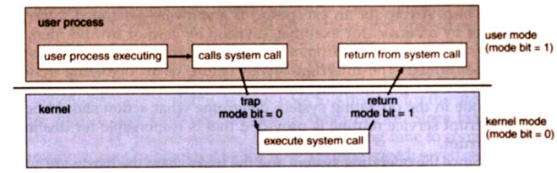
System Calls
program requests a service from an operating system's kernel

Slide 3
Process System Calls
Fork() system call
create child process
Exit System Call
terminate current process

Slide 4
fork() system call
System call fork() is used to create processes.
This system call duplicates the current process
It takes no arguments and returns a process ID.
The purpose of fork() is to create a new process, which becomes the child process of the caller.
After a new child process is created, both processes will execute the next instruction following the fork() system call.

Slide 5
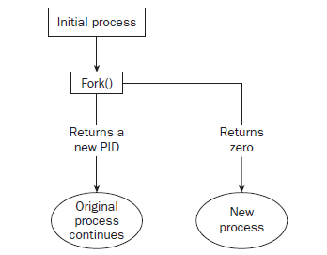
fork() system call

Slide 6
fork() system call
We have to distinguish the parent from the child.
This can be done by testing the returned value of fork():
If fork() returns a negative value, the creation of a child process was unsuccessful.
fork() returns a zero to the newly created child process.
fork() returns a positive value, the process ID of the child process, to the parent.

Slide 7
fork() system call
The returned process ID is an integer, and of type pid_t
A process can use function getpid() to retrieve the process ID assigned to this process.
A process can use function getppid() to retrieve the process ID of its parent process.

Slide 8
fork() system call
Therefore, after the system call to fork(), a simple test can tell which process is the child.
Please note that Unix will make an exact copy of the parent's address space and give it to the child. Therefore, the parent and child processes have separate address spaces.

Slide 9
Library Files
#include <sys/types.h>
#include <unistd.h>
pid_t fork(void);

Slide 11
Fork Example 1
#include <sys/types.h>
#include <stdio.h>
#include <unistd.h>
int main()
{
if (fork()== 0)
printf("In the Child Process\n");
else
printf("Parent Process\n");
return 0;
}

Slide 12
Fork Example 2
#include <sys/types.h>
#include <stdio.h>
#include <unistd.h>
int main()
{
printf("L0 \n ");
fork();
printf("L1\n");
fork();
printf("Bye\n");
return 0;
}

Slide 13
#include <sys/types.h>
#include <stdio.h>
#include <unistd.h>
int main()
{
printf("L0\n");
if (fork()!=0) {
printf("L1\n");
if (fork()!=0) {
printf("L2\n");
fork();
}
}
printf("Bye\n");
return 0;
}

Slide 14
#include <sys/types.h>
#include <stdio.h>
#include <unistd.h>
int main()
{
int x = 1;
pid_t pid = fork();
if (pid == 0) {
printf("Child has x = %d\n", ++x);
} else {
printf("Parent has x = %d\n", --x);
}
printf("Bye from process %d with x = %d\n", getpid(), x);
return 0;
}

Slide 15
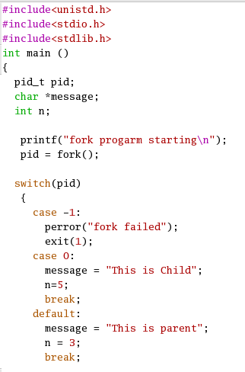
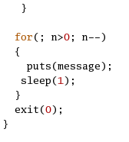
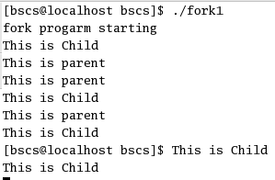
OutPut

Slide 16
getpid(), getppid()
The returned process ID is an integer, and of type pid_t
A process can use function getpid() to retrieve the process ID assigned to this process.
A process can use function getppid() to retrieve the process ID of its parent process.

Slide 17
I/O System Calls
open : system call to open a file :open returns a file descriptor, an integer specifying the position of this open file in the table of open files for the current process .
close : system call to close a file
read : read data from a file opened for reading
write : write data to a file opened for writing
lseek: seek to a specified position in a file (used for random access when reading or writing a file)
link: create a link to a file.
unlink: unlinks a file.

Slide 18
The open() system call
The prototype is
#include <fcntl.h>
int open(const char *path,int oflag);
The return value is the descriptor of the file
Returns -1 if the file could not be opened.

Slide 19
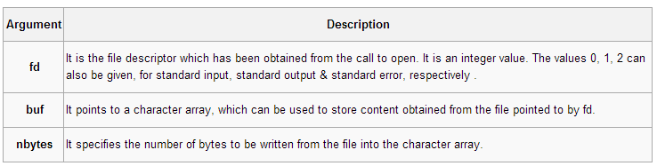
The write() system call
The write() system call is used to write data to a file or other object identified by a file descriptor.
The prototype is
#include <sys/types.h>
size_t write(int fd, const void *buf, size_t nbyte);

Slide 20
The read() system call
The read() system call is used to read data from a file or other object identified by a file descriptor.
The prototype is
#include <sys/types.h>
size_t read(int fd,void *buf,size_t nbyte);

Slide 21
Practice Program
#include<sys/stat.h>
#include<stdio.h>
#include<fcntl.h>
#include<sys/types.h>
int main(){
int n,i=0;
int f1,f2;
char strin[100];
f1=open("data",O_RDWR|O_CREAT|O_TRUNC);

Slide 22
while((c=getchar())!='\n'){
strin[i++]=c;
}
strin[i]='\0';
write(f1,strin,i);
close(f1);
f2=open("data",O_RDONLY);
read(f2,strin,0);
printf("\n%s\n",strin);
close(f2);
return 0;
}

Slide 23
Example
#include<stdio.h>
int main( )
{
int fd:
int b=0,nl=0,c=0;
char ch[1];
fd=open(“text.txt”,O_RDONLY);
while((rc=read(fd,ch,1))>0)
{
if(ch==’ ‘)
b++;
if(ch==’\n’)
nl++;
c++;
}
printf(“no.of blanks %d”,b);
printf(“no.of lines %d”,nl);
printf(“no.of characters %d”,c);
}

